Slide 1

CS-352 Computer Organization and Assembly Language
Lecture 1
Instructor: Aqsa Safdar

Slide 2
Course administration
Instructor: Aqsa Safdar (Lecturer, Deptt of Computer Science, University of Wah, Wah Cantt).
Contact Information: aqsa.safdar@uow.edu.pk

Slide 3

For queries related to course(Assignments/Projects) just leave an email at aqsa.safdar@uow.edu.pk
during office timings 08:00AM - 04:00 PM

Slide 4
Evaluation Criteria (2+1 Credit hrs)
Assessment | %Age
Assignments/ Quizzes | 10 + 15% = 25%
Mid Term Exam | 30%
Final Term Exam | 45%
Total | 100

Slide 5

Quizzes
Assignments
Assignments will be due at the beginning of the class. Under normal circumstances, late work will not be accepted.
Students are expected to do their own assignments.
Plagiarism will be observed strictly.
Oral quizzes to check the understanding of previous lecture before starting the next.
Announced quizzes to assess the understanding of taught topics.

Slide 6

Few Things to Remember
Show sensibility in your conduct.
Learning should be your primary objective.
Attendance will be marked within 10 minutes at the start of the class.
80% of your attendance is mandatory.
Zero tolerance policy on attendance, discipline in class during lectures.
Assignments must be submitted on time, no late submissions.
In case of copied assignment both parties will be given zero.
Don’t miss your Classes, Quizzes, Presentations, Assignments and Projects/Presentations.
You all need to be a good human being.

Slide 7
Course Objectives
The key objectives of this course include:
Understanding Computer System Organization
Assembly Language Programming (MIPS)
Processor Datapath & ALU Design
Processor Architectures & Performance
Memory Hierarchy & System Performance

Slide 8
Course Overview
Foundations & ISA
Assembly Programming
Digital Logic & ALU Design
Processor Datapath & Control (Verilog HDL)
Pipelining & Hazards
Memory Hierarchy & Final Project

Slide 9

CLO Covered in this Lecture:
CLO1: Explain the basic organization of a computer system, instruction set architecture (ISA), and processor performance metrics to understand how hardware executes programs.

Slide 10
Why Study COAL?
Understand how software interacts with hardware
Bridge the gap between high-level programming and machine execution
Core knowledge for system-level understanding
AI works faster when the hardware is powerful and efficient.
Cybersecurity requires low-level system understanding
Embedded systems demand processor-level programming
Analyze execution time and CPI
Understand pipeline and cache performance
Write efficient, optimized programs using MIPS / Assembly programming
Verilog HDL design
Processor data path & control implementation

Slide 11
Reasons to Study COAL
Understand how a computer works internally (CPU, memory, registers).
Learn how instructions are executed inside the processor.
Improve problem-solving skills at hardware level.
Optimize performance by understanding memory and processing.
Build strong foundation for advanced subjects like Operating Systems and Computer Architecture.

Slide 12
Real life uses of Assembly Language
Used in embedded systems like ATMs, traffic lights, and home appliances
Used in operating systems for low-level tasks
Used to write device drivers (keyboard, printer, graphics card)
Used in game development for speed optimization
Used in cybersecurity for malware analysis and reverse engineering
Used in microcontrollers and small hardware devices
Used where high speed and direct hardware control are required

Slide 13
Why Assembly is Used for High-Speed Applications?
We talk about speed in Assembly because:
Assembly language is very close to machine code.
It gives direct control over CPU and registers.
There is no extra layer (like compiler overhead) as in high-level languages.
Programs written in Assembly use less memory.
That’s why Assembly is used where high speed and performance are required, such as:
Real-time systems (traffic control, medical devices)
Game engines (graphics processing)
Embedded systems
Device drivers

Slide 14
Lecture Outline
Components of a Computer System:
Input Unit
Output Unit
CPU
Memory
Definition of Computer Organization vs Computer Architecture
Functional Units
Von Neumann Architecture
Performance Metrics (Execution Time, CPI)

Slide 15
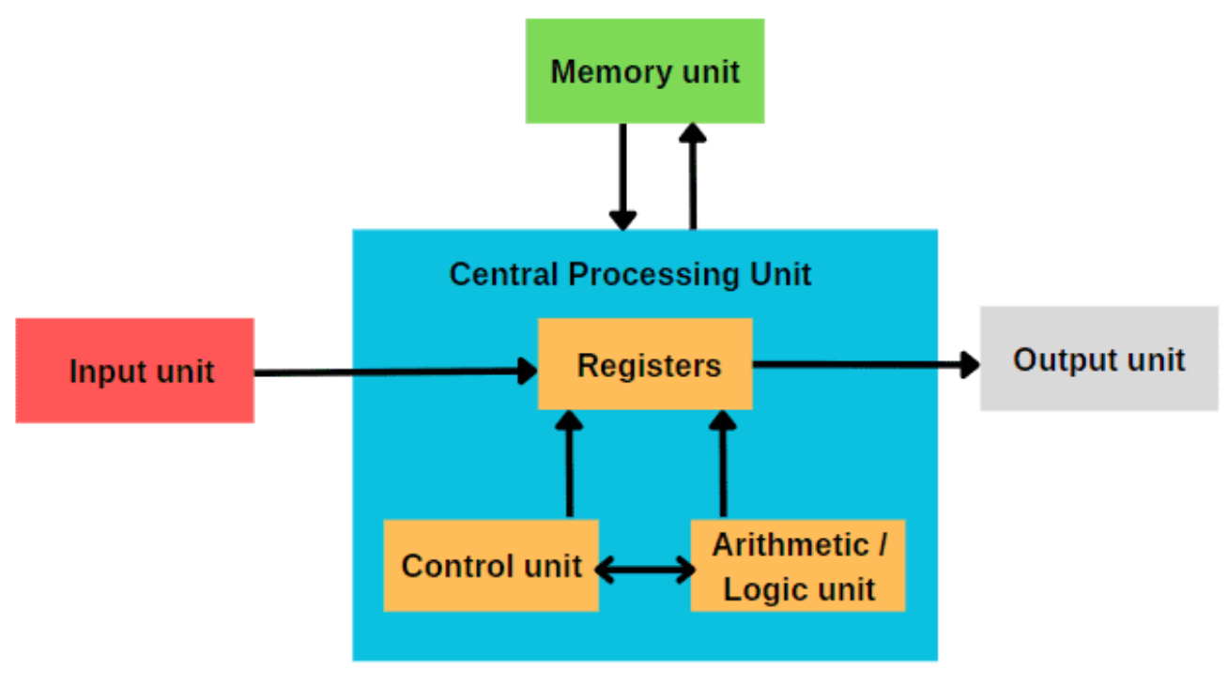
Components of a Computer System
Components of a Computer System
Input Unit
Output Unit
CPU
Memory
Notes:
Input → Registers → Control Unit → ALU → Memory → Output
The user gives input → the CPU processes it → the result is shown as output.

Slide 16
Input/output Devices
Input Unit: Takes data from the user and sends it to the CPU.
Registers: Store data temporarily inside the CPU (very fast).
Control Unit (CU): Controls and manages all operations of the CPU.
ALU (Arithmetic Logic Unit): Performs calculations and logical operations.
Memory Unit: Stores data and instructions.
Output Unit: Displays the final result to the user.
Work Flow :
Input Unit → Registers → Control Unit → ALU → Memory Unit → Registers (if needed) → Output Unit

Slide 17
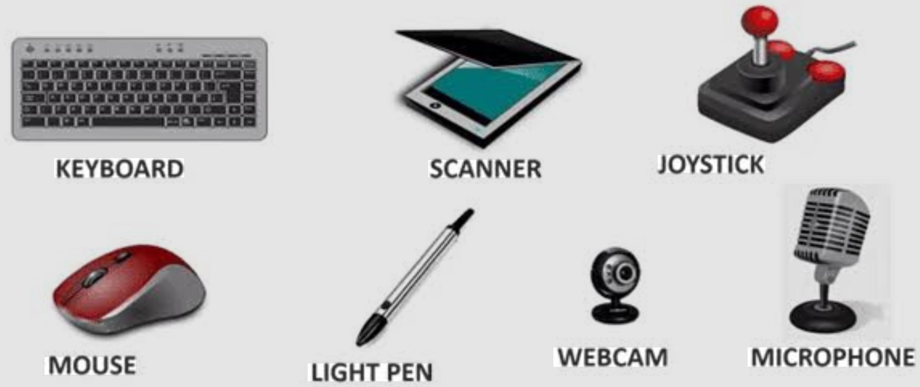
Input Unit
Accepts data and instructions
Converts input into binary form
Examples:
Keyboard
Mouse
Scanner
Microphone
Example:
When typing:
5 + 3
Keyboard converts keystrokes into binary signals.

Slide 18
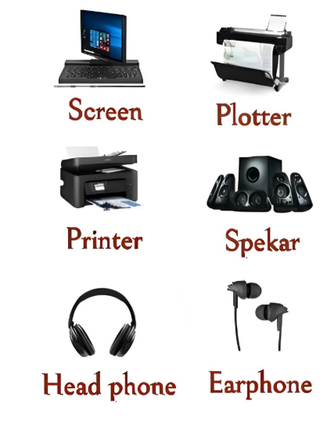
Output Unit
Converts processed binary results into human-readable form
Examples:
Monitor
Printer
Speakers
Example:
After computation:
8 displayed on screen.

Slide 19
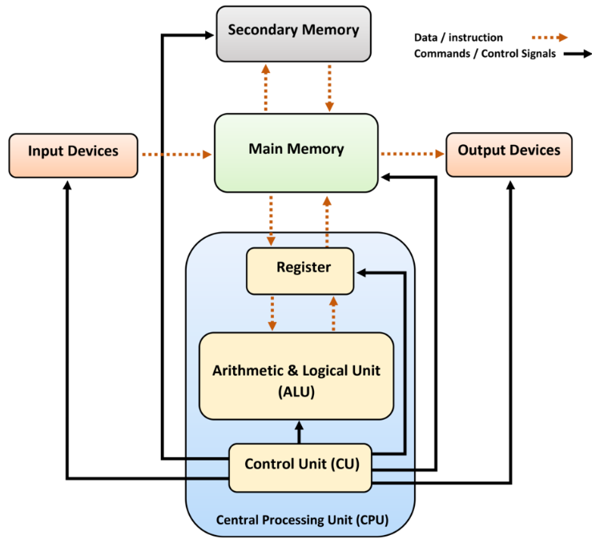
Central Processing Unit (CPU)
The CPU is the brain of the computer.
It consists of:
Control Unit (CU)
Arithmetic Logic Unit (ALU)
Registers
Notes:
Some systems, especially fast CPUs or microcontrollers, send input directly to CPU registers instead of first storing it in main memory.

Slide 20
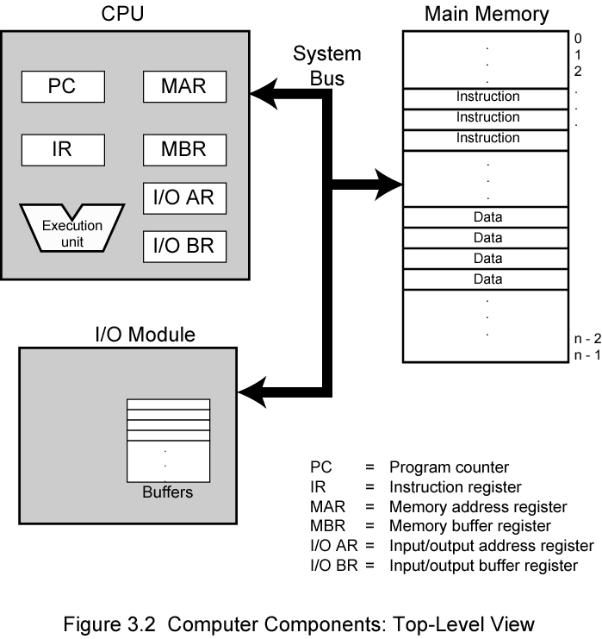
Functional Units of CPU
Control Unit (CU)
Directs operations
Sends control signals
Manages instruction execution
ALU
Performs arithmetic (+, −)
Performs logical (AND, OR)
Registers
Small, fast storage
Examples:
PC (Program Counter)
IR (Instruction Register)
Notes:
PC (Program Counter): Holds the address of the next instruction.
MAR (Memory Address Register): Holds the memory address of data or instruction being accessed.
MAR accesses that instruction from Main Memory (M).The instruction is placed into MBR
IR (Instruction Register): Stores the current instruction.
I/O AR (I/O Address Register): Holds the address of the I/O device that the CPU wants to communicate with.
I/O BR (I/O Buffer Register): Temporarily holds data being transferred between the CPU and the I/O device.

Slide 21
Memory Unit
Stores:
Instructions
Data
Types:
RAM
ROM
Cache
Example:
Program stored in memory:
add $t0, $t1, $t2

Slide 22
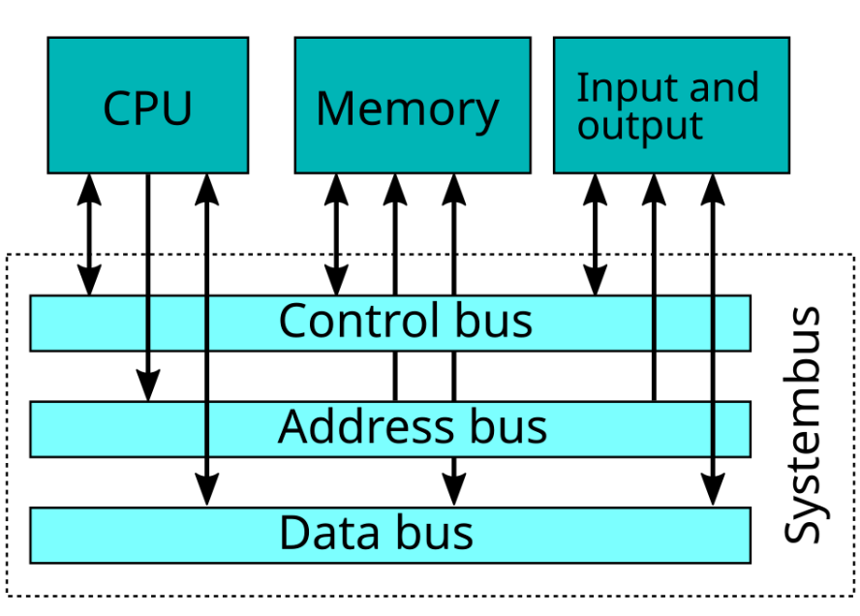
Buses
Data is transmitted from one part of a computer to another, connecting all major internal components to the CPU and memory, by the means of Buses. Types:
Data Bus: It carries data among the memory unit, the I/O devices, and the processor.
Address Bus: It carries the address of data (not the actual data) between memory and processor.
Control Bus: It carries control commands from the CPU (and status signals from other devices) in order to control and coordinate all the activities within the computer.

Slide 23
Computer Architecture
Computer Architecture Refers to those features of a computer system that are visible to the programmer meaning, things that affect how you write program.
Examples:
The instruction set (what operations the CPU can perform — e.g., add, subtract, multiply)
The number of bits used to represent data (8-bit, 16-bit, 32-bit, 64-bit)
The data representation (how 1’s and 0’s are used)
The addressing modes (how the CPU accesses data in memory
When you write:
int a = b + c;
Architecture defines:
Which instruction performs addition
Which registers are used
How operands are accessed
Notes:
Architecture is a logical design
Organization is a physical design

Slide 24
Computer Architecture
ISA is the set of instructions, registers, and data formats that define how software communicates with hardware.
Data types specify the kind and size of data a processor can store and manipulate (e.g., integer, float, character).
Addressing modes define how an instruction specifies the location of its operands in memory or registers.
Registers are small, high-speed storage locations inside the CPU used to hold data and instructions temporarily.
Memory model describes how data and instructions are organized and accessed within the system’s memory structure.
Notes:
Architecture is like the architectural blueprint of a house.
It defines:
Number of rooms
Size of rooms
Kitchen layout
Doors and windows placement
Electrical and plumbing plan

Slide 25
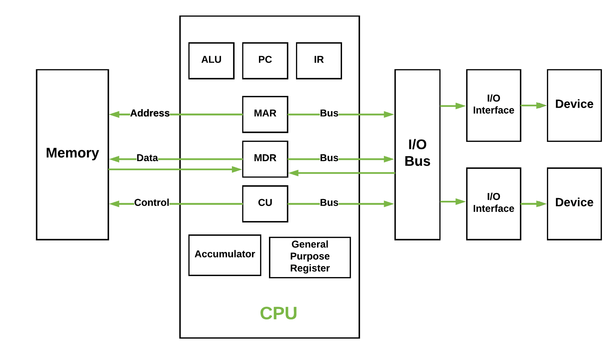
Computer Organization
Computer Organization refers to how hardware components are arranged and interconnected to implement the architecture. Focus on how the computer is built?
Includes:
Datapath design
Control signals
ALU structure
Pipeline implementation
Notes:
Organization is like how the house is physically constructed.
It defines:
What materials are used (brick, concrete, wood)
Wiring implementation
Pipe layout
Foundation structure
Quality of insulation

Slide 26
Computer Organization
Datapath design refers to the arrangement of hardware components (ALU, registers, multiplexers, buses) that move and process data inside the CPU.
Control signals are electrical signals generated by the control unit to direct the operation of data path components during instruction execution.
ALU structure defines the internal hardware organization of the Arithmetic Logic Unit that performs arithmetic and logical operations.
Pipeline implementation is a processor design technique that divides instruction execution into stages to execute multiple instructions simultaneously for improved performance.

Slide 27
Von Neumann Architecture
It uses single memory to store both the program instructions and the data.
The CPU fetches instructions and data from the same place, one after another.
This design is simpler and used in most traditional computers.
Features:
Stored program concept
Shared bus
Sequential execution

Slide 28
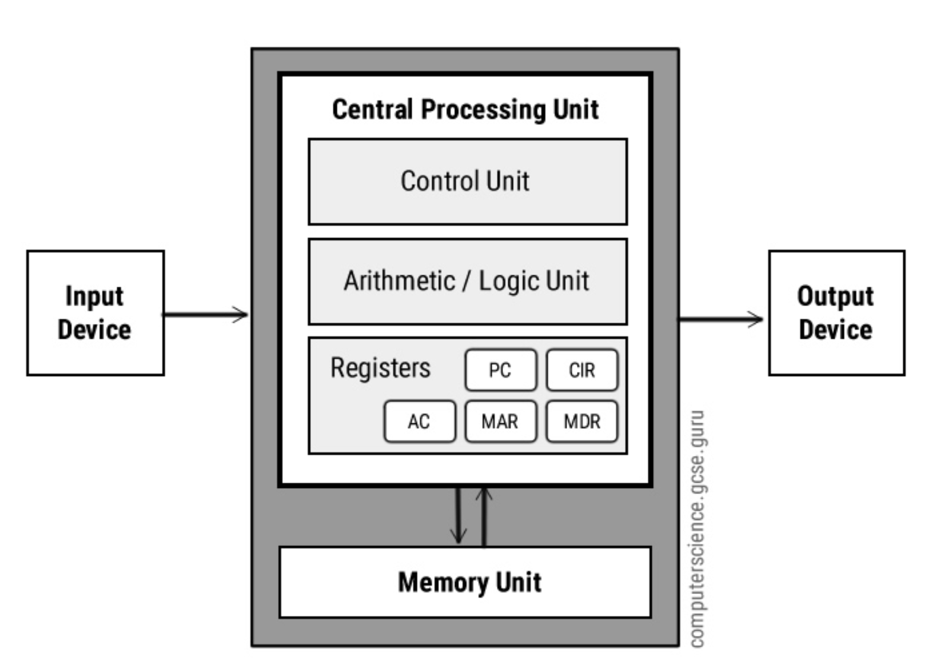
Von Neumann Architecture

Slide 29
Registers
Accumulator: Stores the results of calculations made by ALU.
Program Counter (PC): Keeps track of the memory location of the next instructions to be dealt with. The PC then passes this next address to Memory Address Register (MAR).
Memory Address Register (MAR): It stores the memory locations of instructions that need to be fetched from memory or stored into memory.
Memory Data Register (MDR): It stores instructions fetched from memory or any data that is to be transferred to, and stored in, memory.
Current Instruction Register (CIR): It stores the most recently fetched instructions while it is waiting to be coded and executed.
Instruction Buffer Register (IBR): The instruction that is not to be executed immediately is placed in the instruction buffer register IBR.

Slide 30
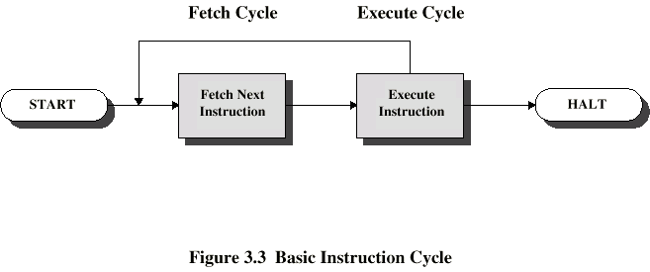
Stored Program Concept
Program is stored in memory like data.
Execution cycle:
Fetch
Decode
Execute
This is called the Instruction Cycle.

Slide 31
Stages of Fetch decode cycle
Fetch is the step where the CPU retrieves the next instruction from memory using the Program Counter (PC).
Decode is the step where the CPU interprets the fetched instruction to determine the required operation and operands.
Execute is the step where the CPU performs the operation specified by the instruction using the ALU or other functional units.

Slide 32
Instruction Execution Cycle
Notes:
It shows how:
Instructions are stored in Program Memory (RAM)
Data is stored in Data Memory (RAM)
CPU processes instructions using:
PC (Program Counter)
Instruction Queue
Registers
ALU
Results are written back to memory

Slide 33
Step 1: Fetch
What Happens?
The Program Counter (PC) holds the address of the next instruction.
The CPU fetches instruction I-1, I-2, I-3, I-4 from Program RAM.
The fetched instruction goes to the Instruction Queue.
Example:
If PC = 1000 Instruction at 1000 is:
add $t0, $t1, $t2
This instruction is fetched.

Slide 34
Step 2: Decode:
What Happens?
The instruction moves from the Instruction Queue.
CPU decodes it:
Identifies operation (add)
Identifies operands ($t1, $t2)
In the diagram:
Instruction Queue → decode → Registers
The CPU reads operand values from registers.

Slide 35
Step 3: Execute
What Happens?
Operands go to the ALU
ALU performs the operation
In the diagram: Registers → ALU → execute
Example:
If: $t1 = 5 $t2 = 3
ALU performs: 5 + 3 = 8

Slide 36
Step 4: Store Result
After execution:
Result is stored back to:
A register OR
Data Memory (RAM)
In the diagram: ALU → store the output → Data RAM or Registers

Slide 37
Data Memory
Data (RAM) op1 op2
Stores:
Variables
Arrays
Operands
If instruction is:
lw $t0, 0($t1) # load data from memory to registers
Data is fetched from Data RAM.

Slide 38
Contd…
Registers:
Temporarily store operands
Very fast storage inside CPU
Example registers:
$t0
$t1
$s0
PC
ALU
Performs arithmetic operations
Performs logical operations
Produces result

Slide 39
Performance Metrics
Why measure performance?
Compare processors
Optimize systems
Improve efficiency

Slide 40
Execution Time
Execution Time = Total time to run a program
Two types:
Elapsed Time (Wall-clock)
CPU Time
Example:
If a program takes 5 seconds → Execution time = 5 sec.

Slide 41
CPU Performance
CPU Time= IC × CPI × CCT
Where:
IC= Instruction Count
CPI = Cycles Per Instruction need
CCT= Clock Cycle Time
Cycle 1
Cycle 2
Cycle 3

Slide 42

CPI (Cycles Per Instruction)
CPI tells how many clock cycles each instruction needs.
Example:
IC = 1000
CPI = 2
Clock cycle = 1 ns
$$CPU Time=1000×2×1ns=2000ns$$

Slide 43
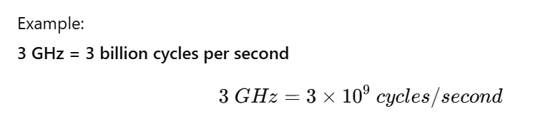
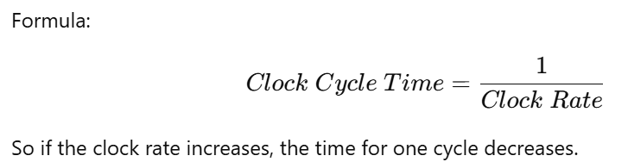

Clock Rate vs Clock Cycle
Clock rate tells how many clock cycles a CPU performs in one second. It is usually measured in Hz, MHz, or GHz.
$\text{Clock} \text{cycle} \text{time} \text{is} \text{the} \text{time} \text{required} \text{to} \text{complete} \text{one} \text{clock} \text{cycle}\text{.}$
Notes:
Higher clock rate → shorter cycle time → faster execution

Slide 44
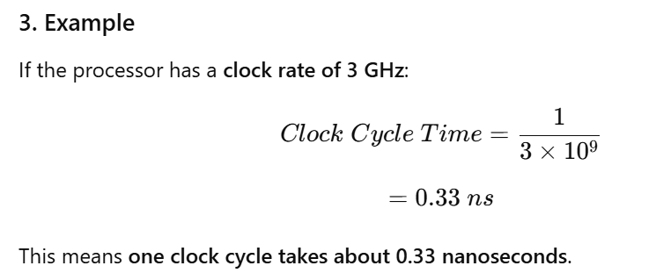
Clock Cycle
Relationship
Higher clock rate → more cycles per second
More cycles → instructions processed faster
Shorter clock cycle time → faster execution
So:
Higher clock rate → shorter cycle time → faster execution

Slide 45
Task
Processor A:
CPI = 1
Clock = 2 GHz
Processor B:
CPI = 2
Clock = 3 GHz
Calculate which is faster?

Slide 46
Summary
Architecture vs Organization
Functional Units
Von Neumann Model
Stored Program Concept
Execution Time
CPI
Performance Formula

